Slide 1
INTERIN PRESENTATION
PROJECT NAME: UNIX SHELL AND HISTORY FEATURE
COURSE: OPERATING SYSTEM

Slide 2
FEATURES FOR INTERIM
String Input of commands
Showing history of last 10 executed commands
Running programs in background with the help of paren child processes
Showing error message when give wrong command

Slide 3
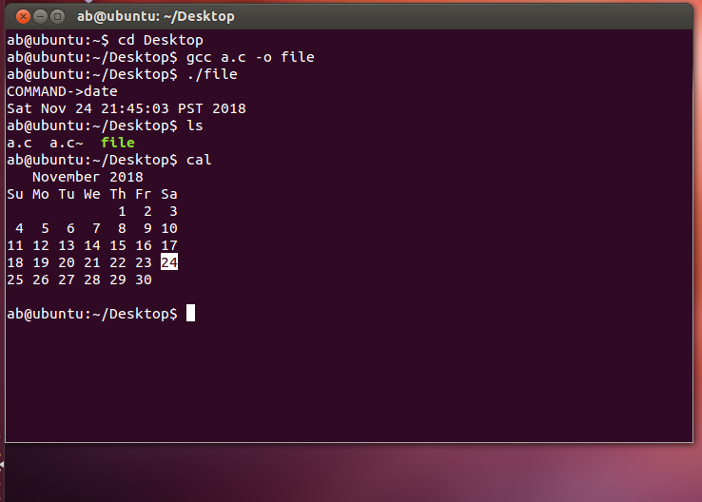
STRING INPUT

Slide 4
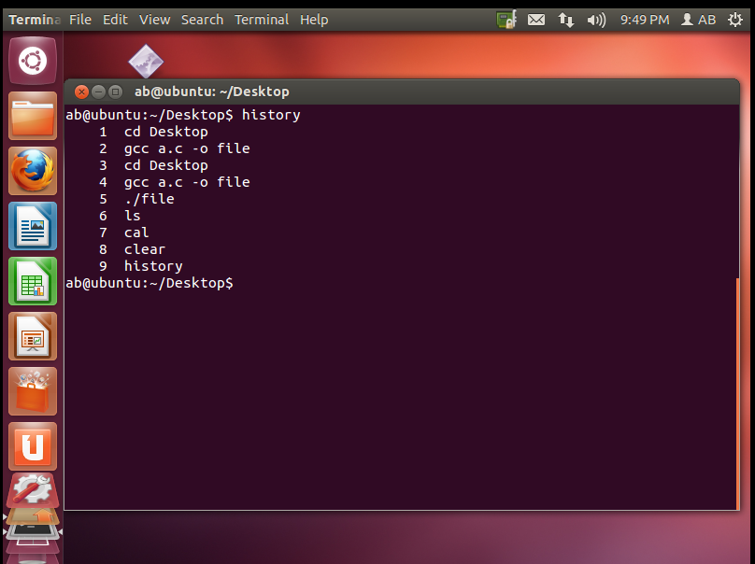
HISTORY

Slide 5
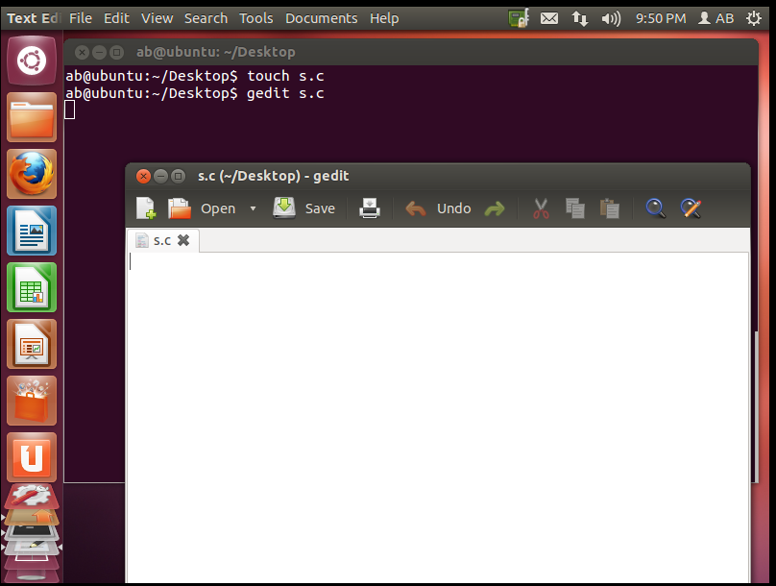
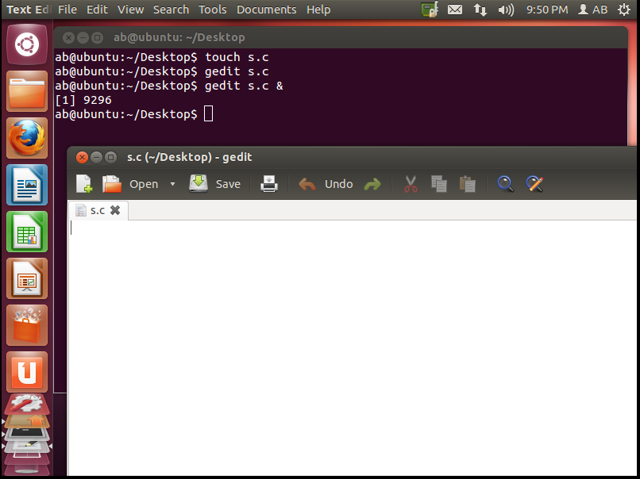
BACKGROUND RUNNING WITH OR WITHOUR “&”

Slide 6
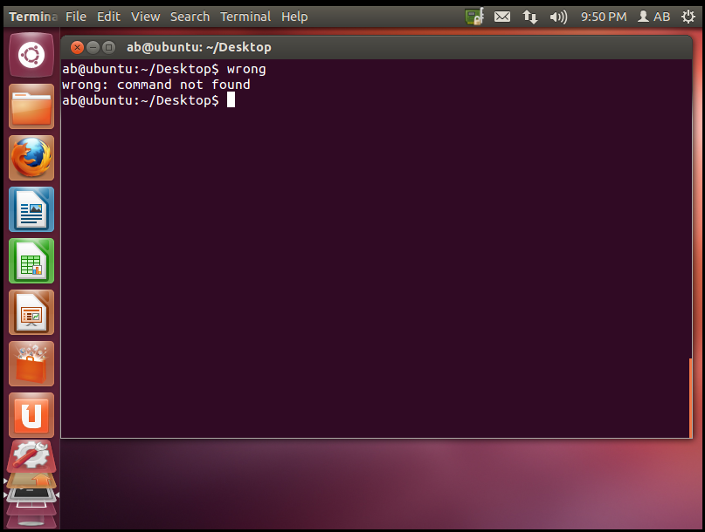
WRONG COMMAND

Slide 7
THANK YOU

